Slide 1
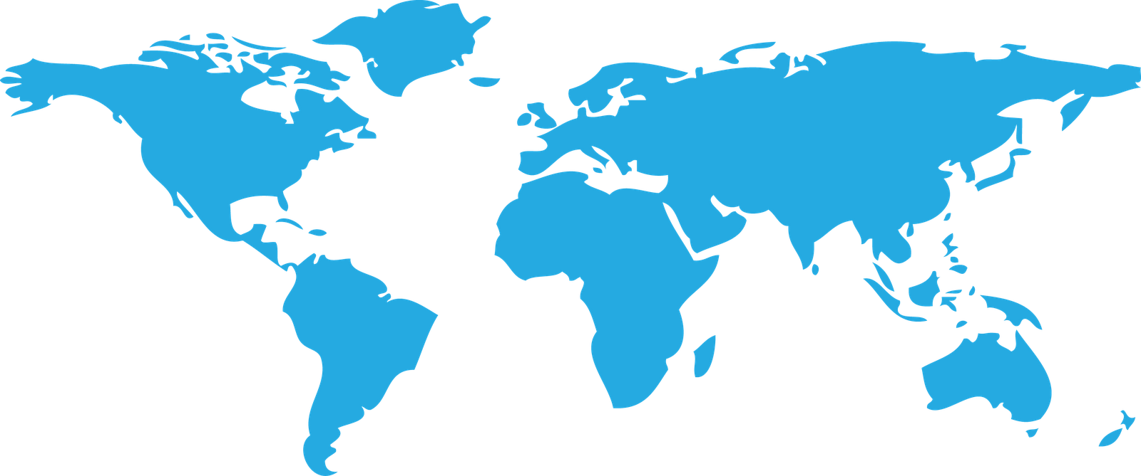

Hello!
We are Deon and Ben
Let's talk about DEATH!

Slide 2
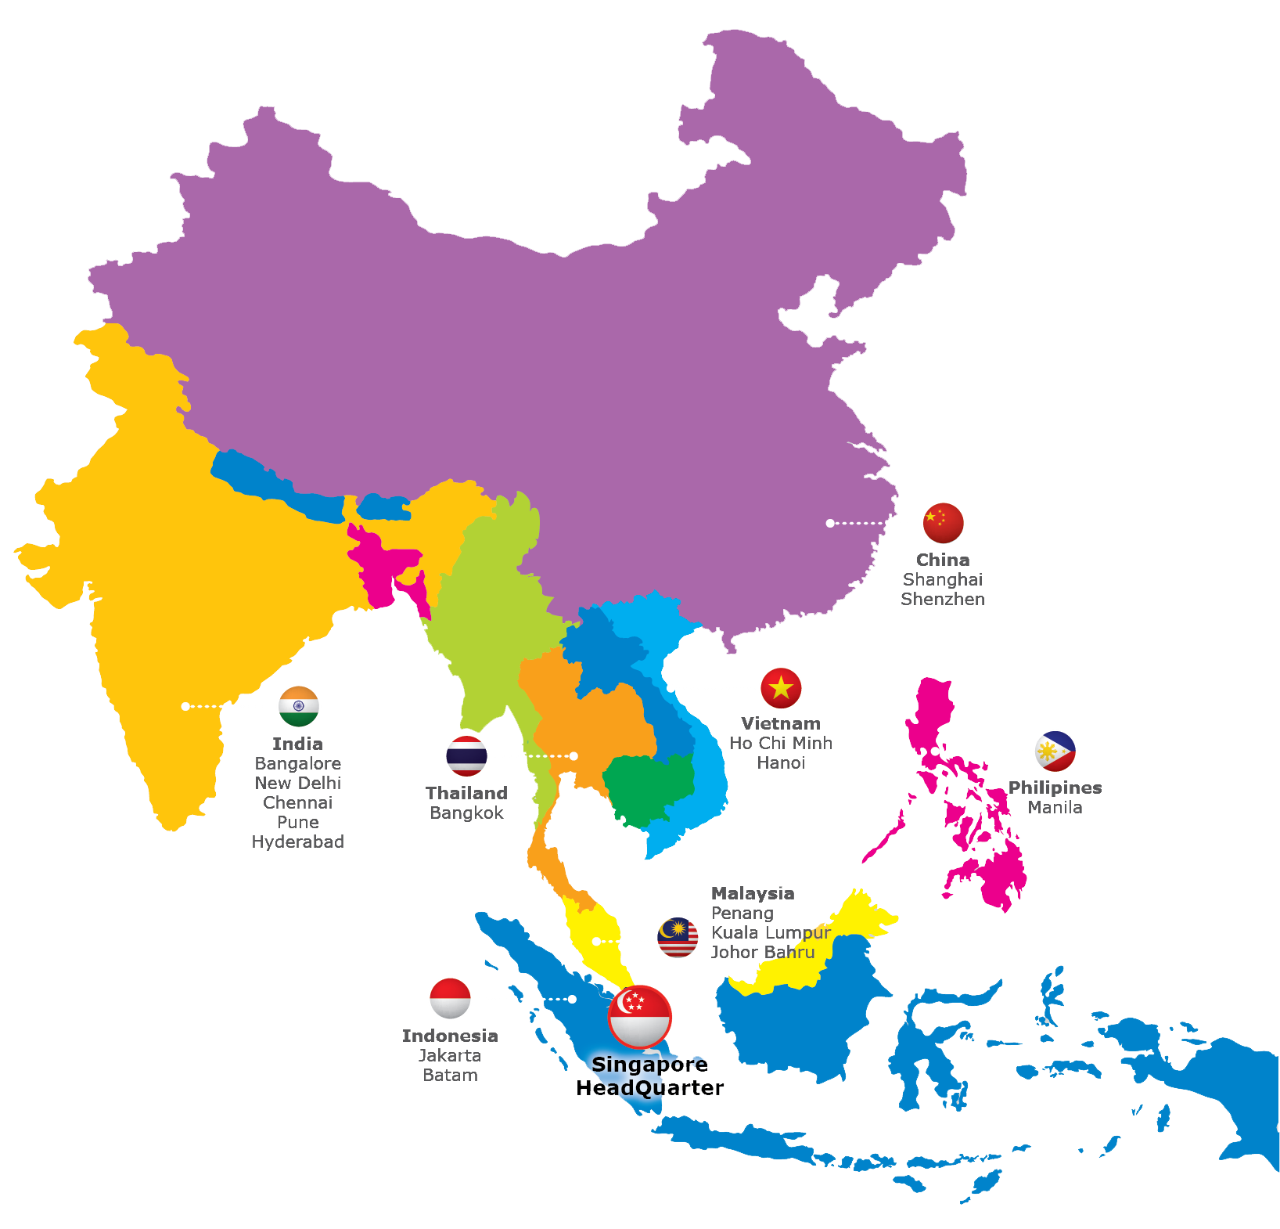

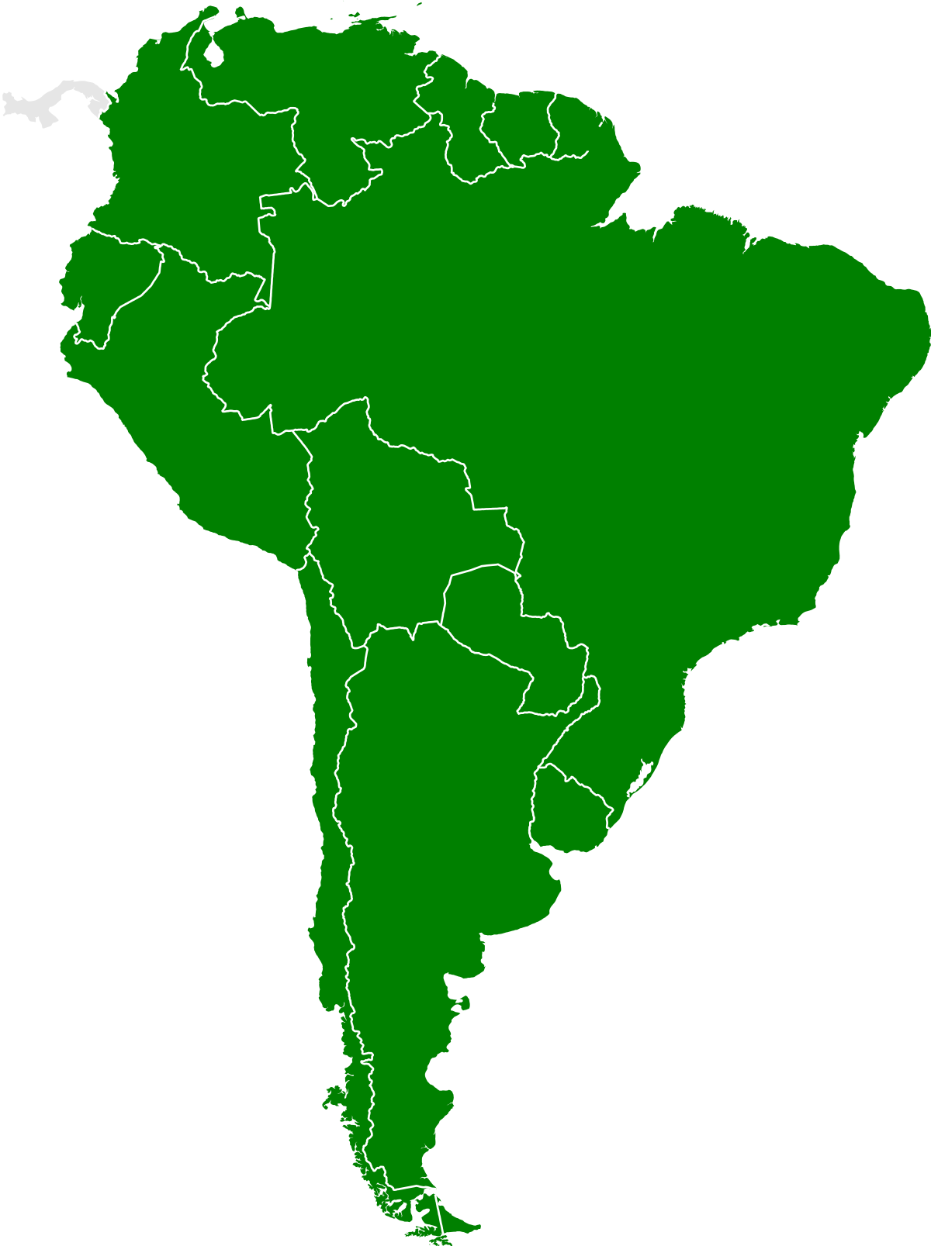
Let’s go on a Spring Vacation!

Slide 3

Act I: The Cleaning
How did we clean our data?

Slide 4

Source?
Our data is sourced from Our World in Data, an organization that archives research and data concerning worldwide health for online consumption.
ourworldindata.org

Slide 5


Cleaning
Clean names
Pivoting Longer
Limiting Causes of Death
Limiting Countries

Slide 6
Act II: The App

Slide 7
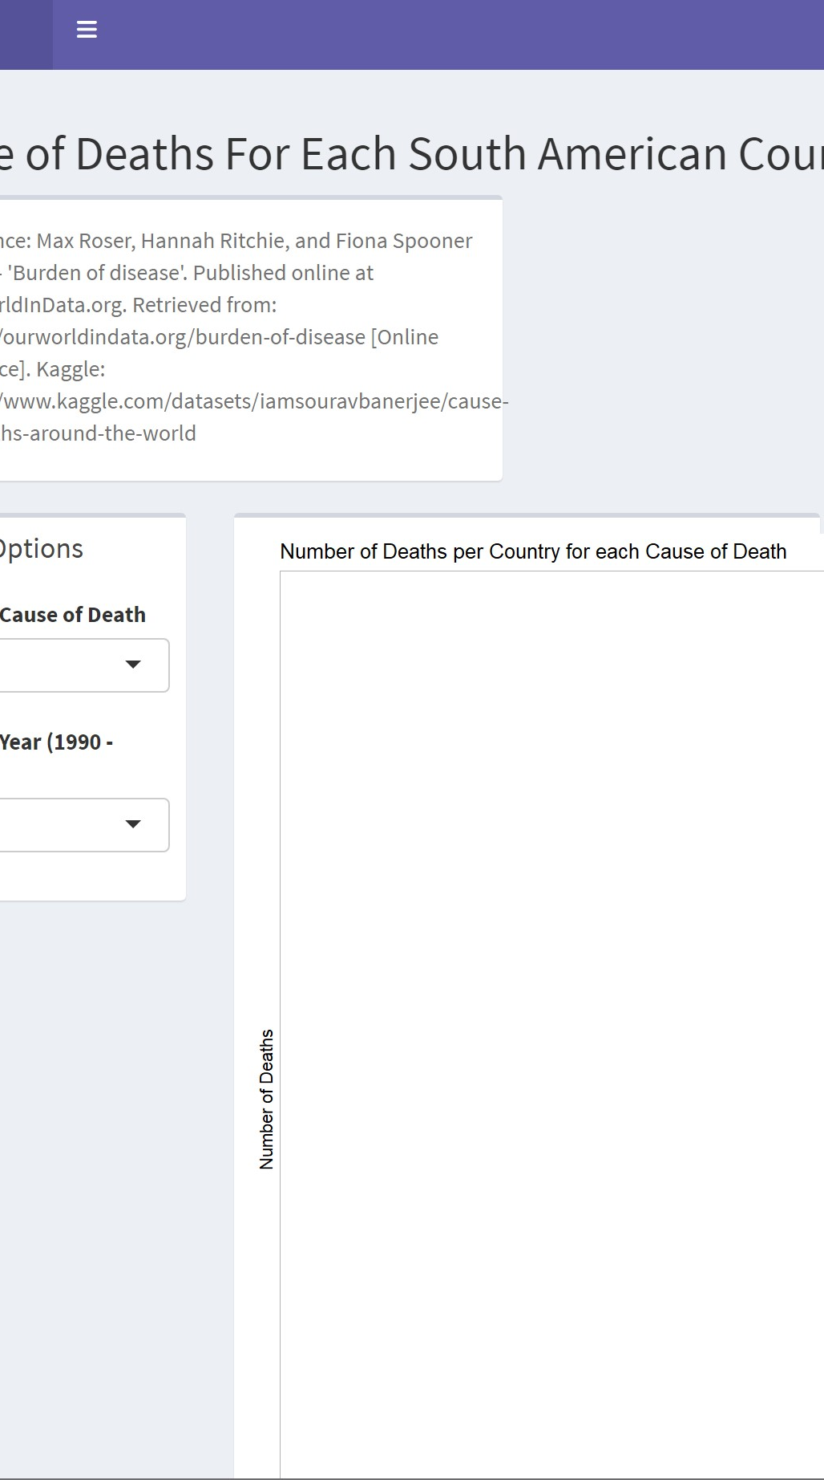
So where are we going?
Let’s use our app for travel safety based on trends…
Credit:
Ben – East Asia
Deon – South America

Slide 8
Act III: Dive Deeper
Based off our app, what trends did we see and why?

Slide 9




Countries to be we’ve picked to discuss

Slide 10

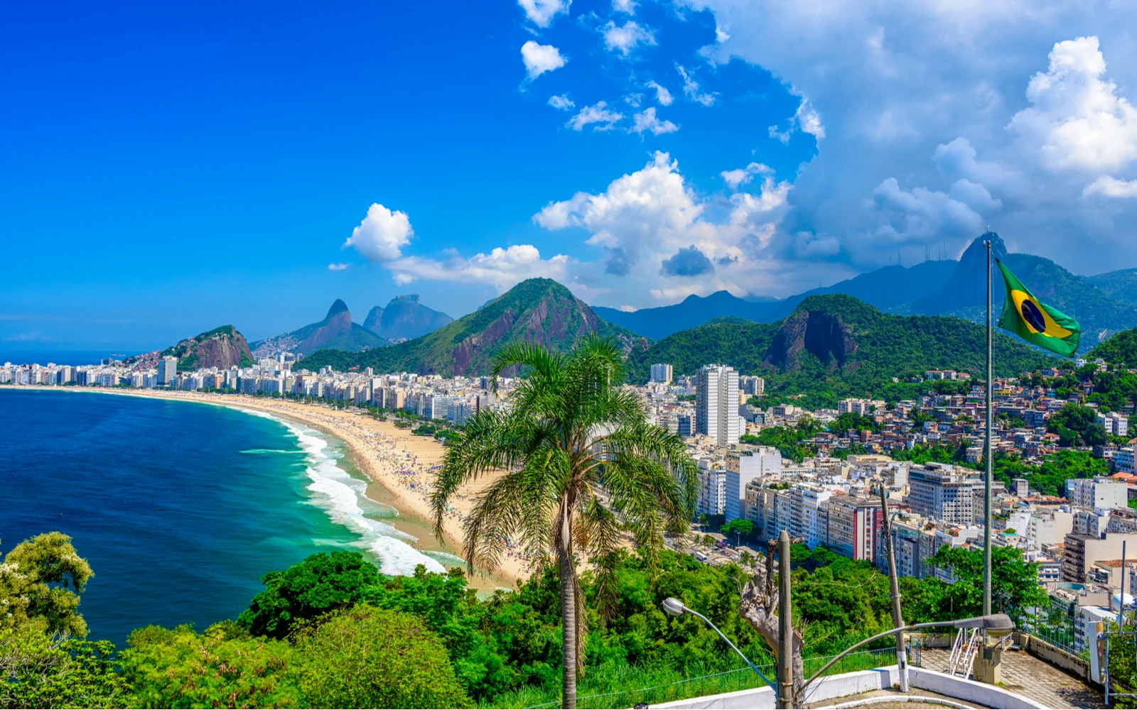
Brazil
Notes:
Rising case of Digestive Diseases and Interpersonal Violence

Slide 11
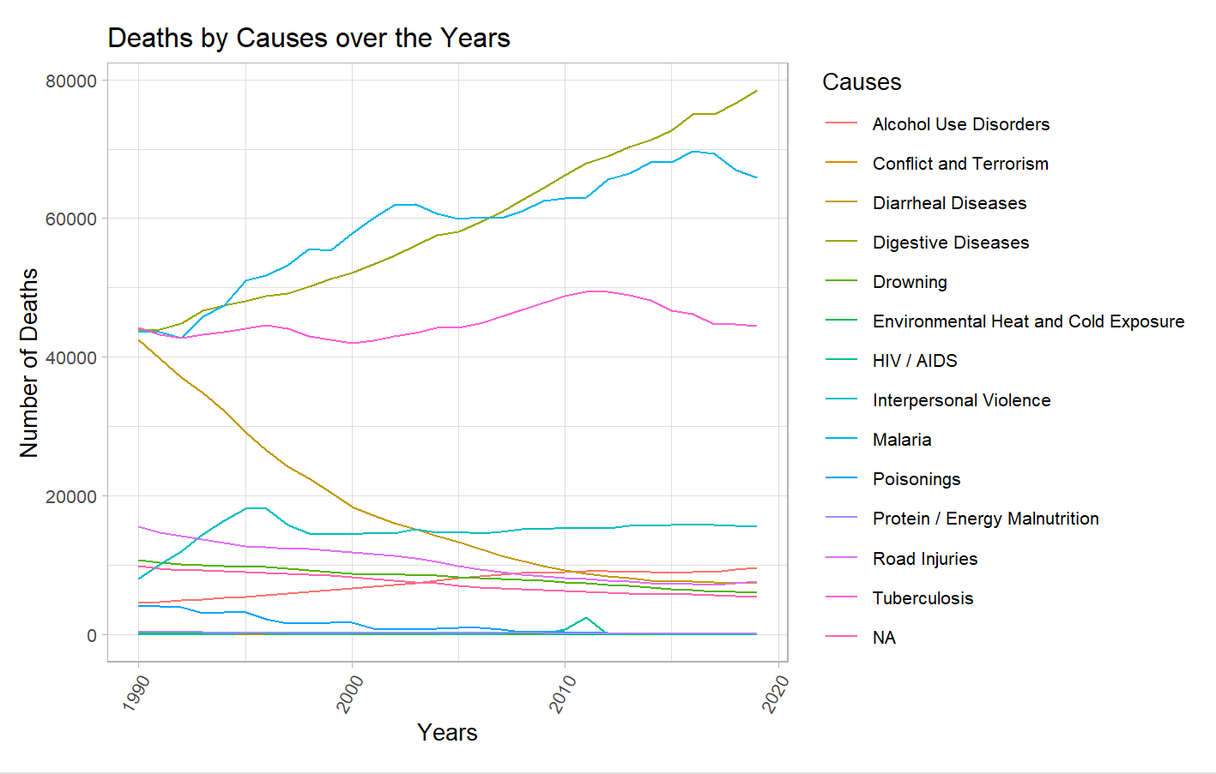
Brazil
Notes:
Rising case of Digestive Diseases and Interpersonal Violence

Slide 12
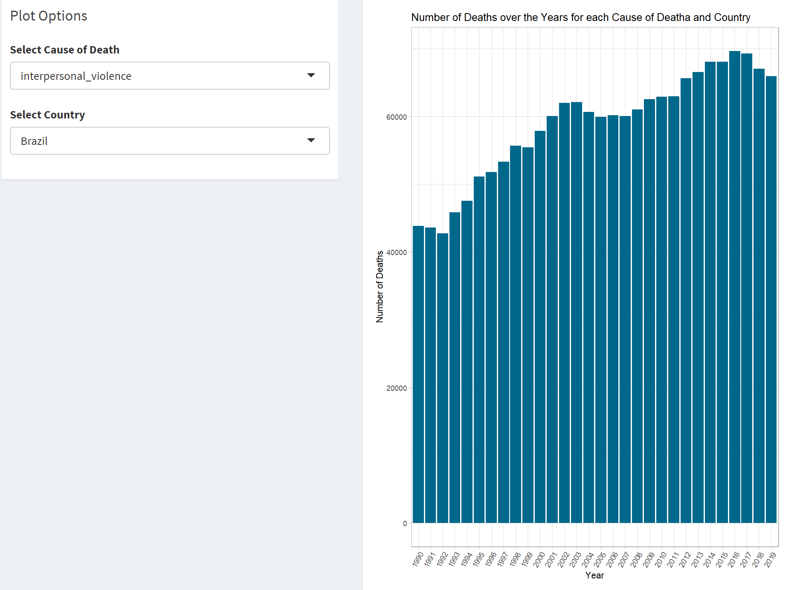
Brazil – Rising Interpersonal Violence

Slide 13
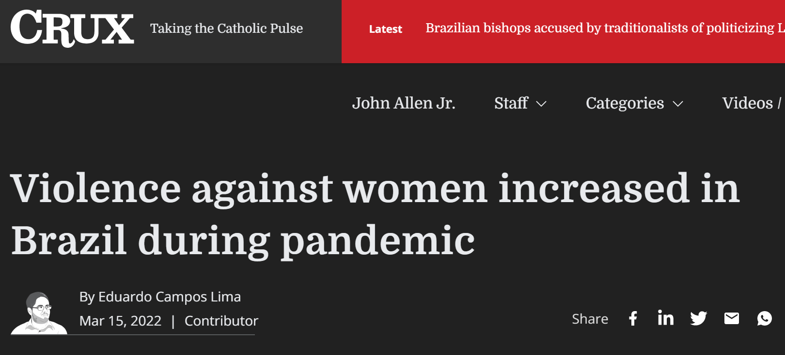
Brazil

Slide 14
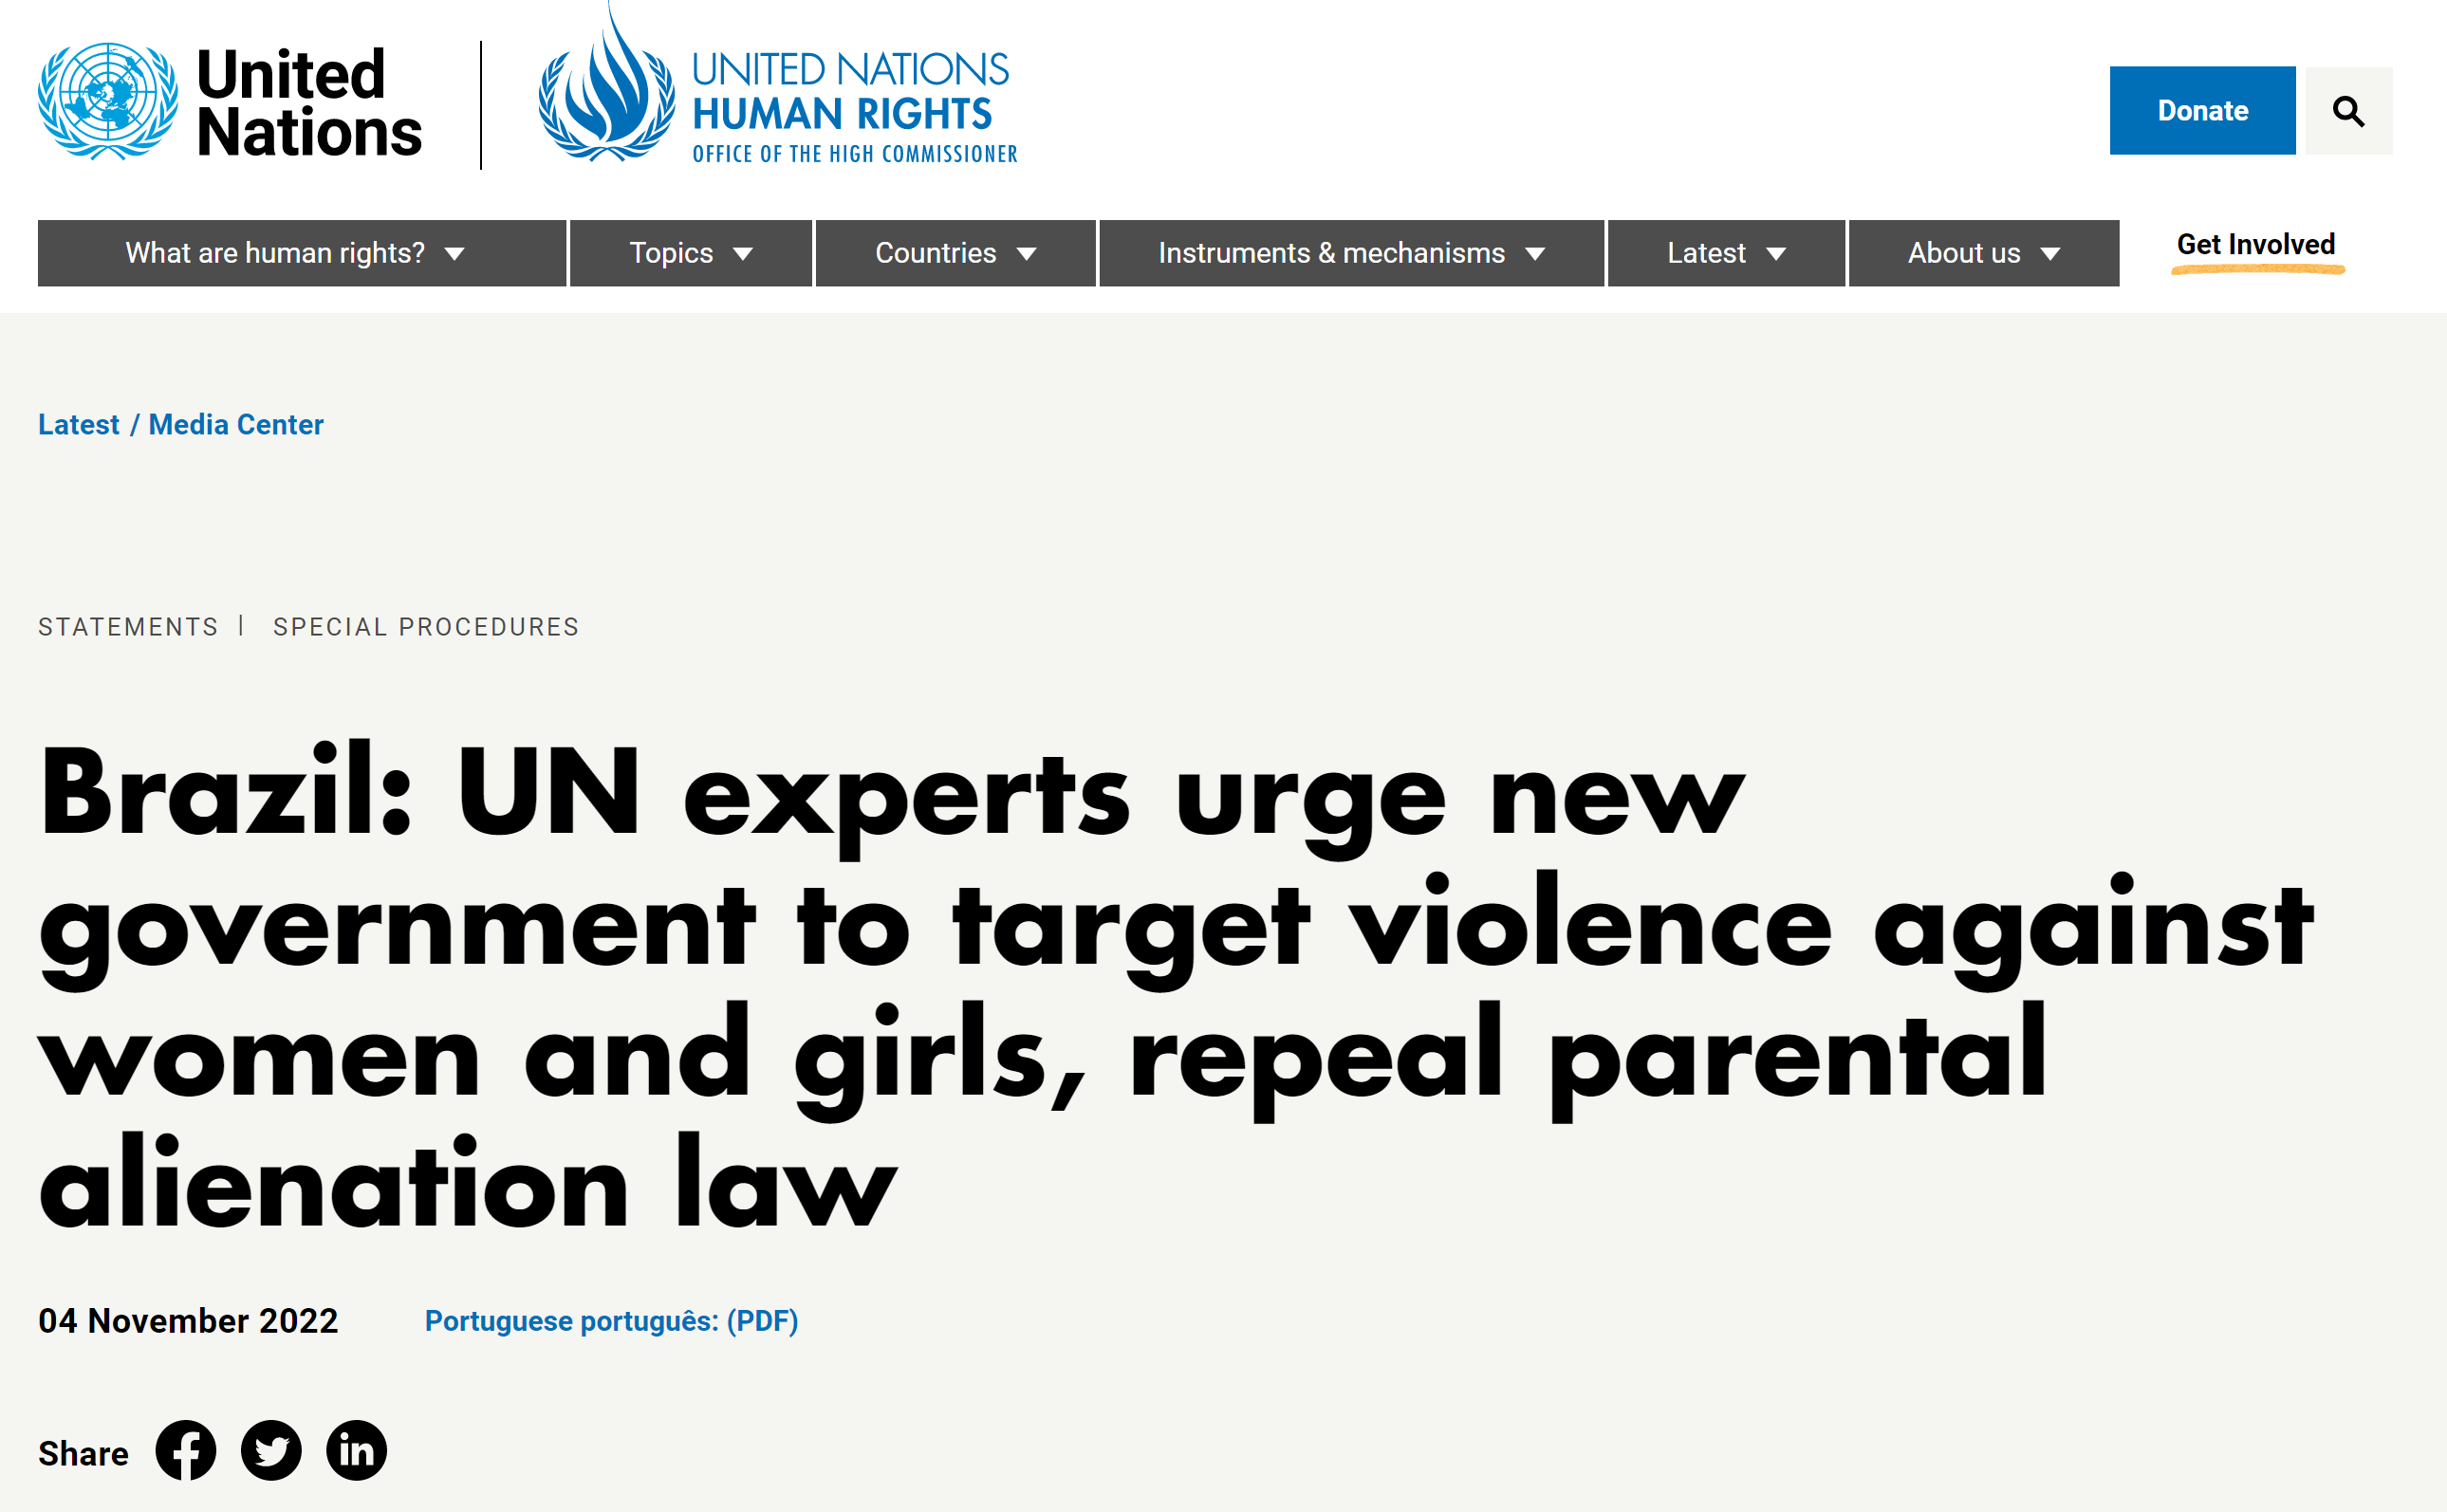
Brazil

Slide 15
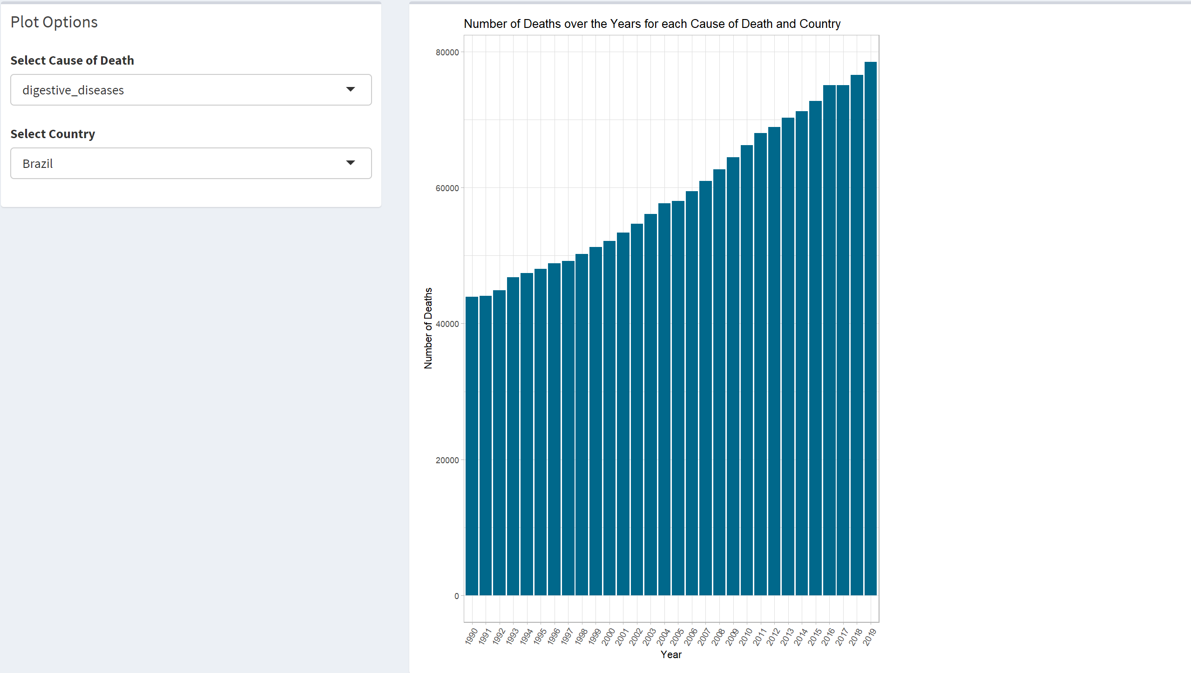
Brazil – Rising Digestive Diseases

Slide 16
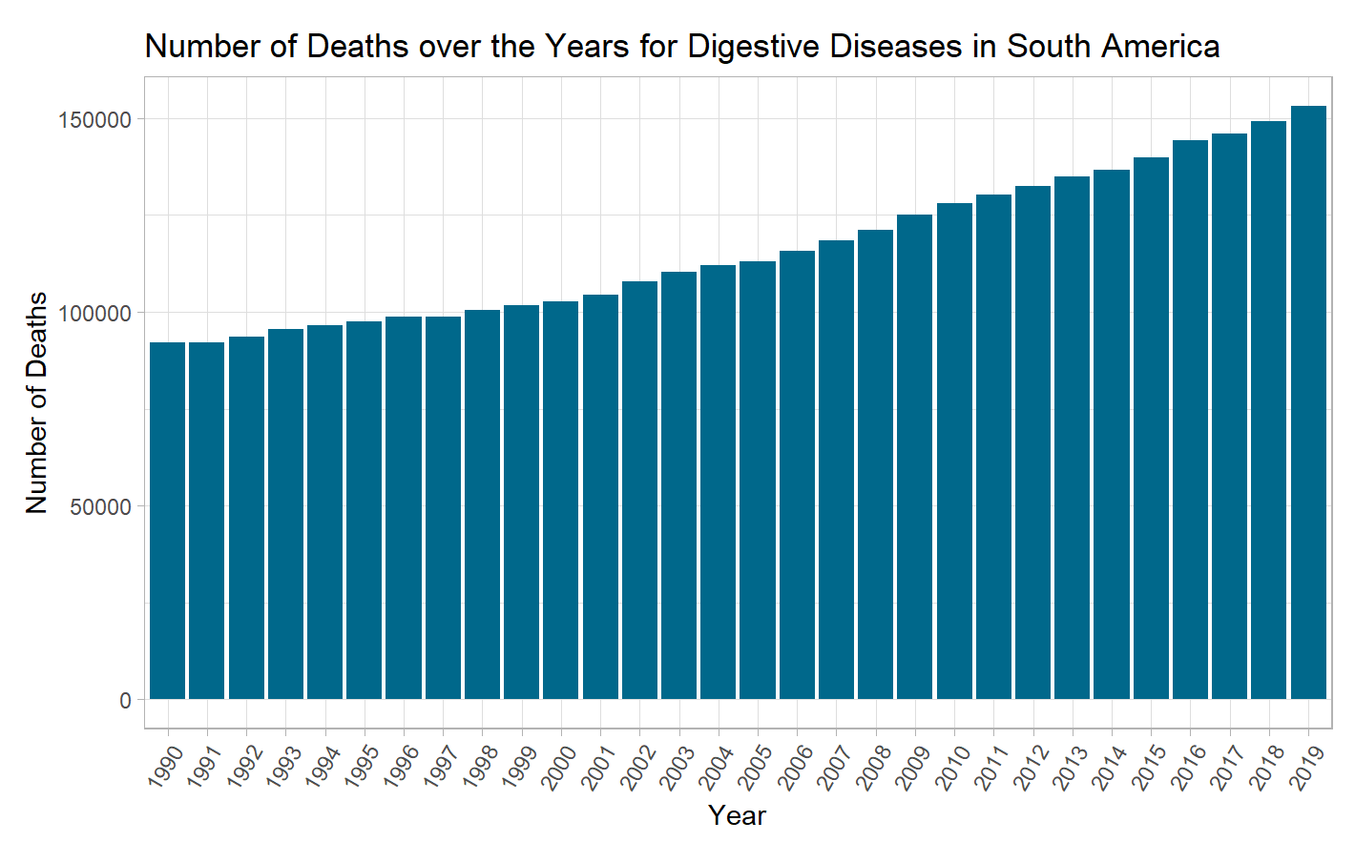
Common Trend Across South America

Slide 17
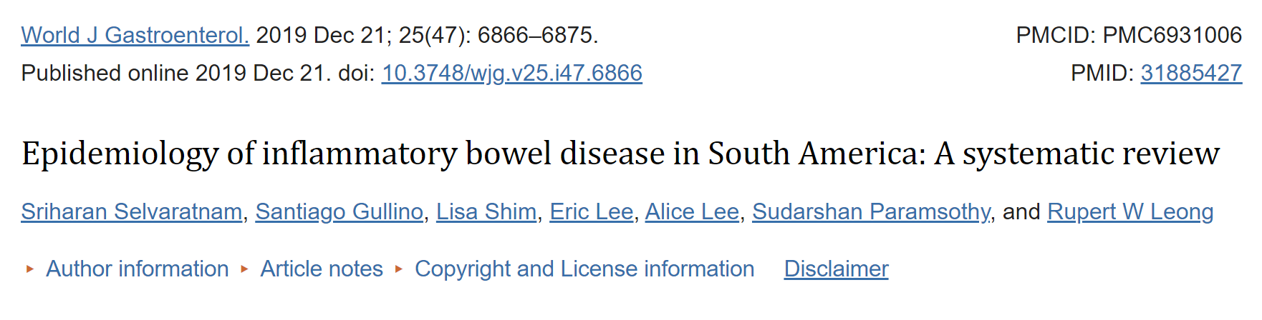
Brazil – Rising Digestive Diseases
Poor and unsanitary living conditions
Systematic racism
Many Indigenous and African Descendants have no access to clean water

Slide 18
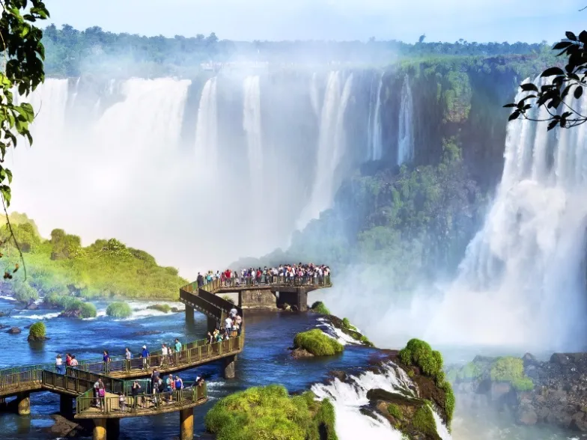

Argentina
Notes:
Rising case of Digestive Diseases and Interpersonal Violence

Slide 19
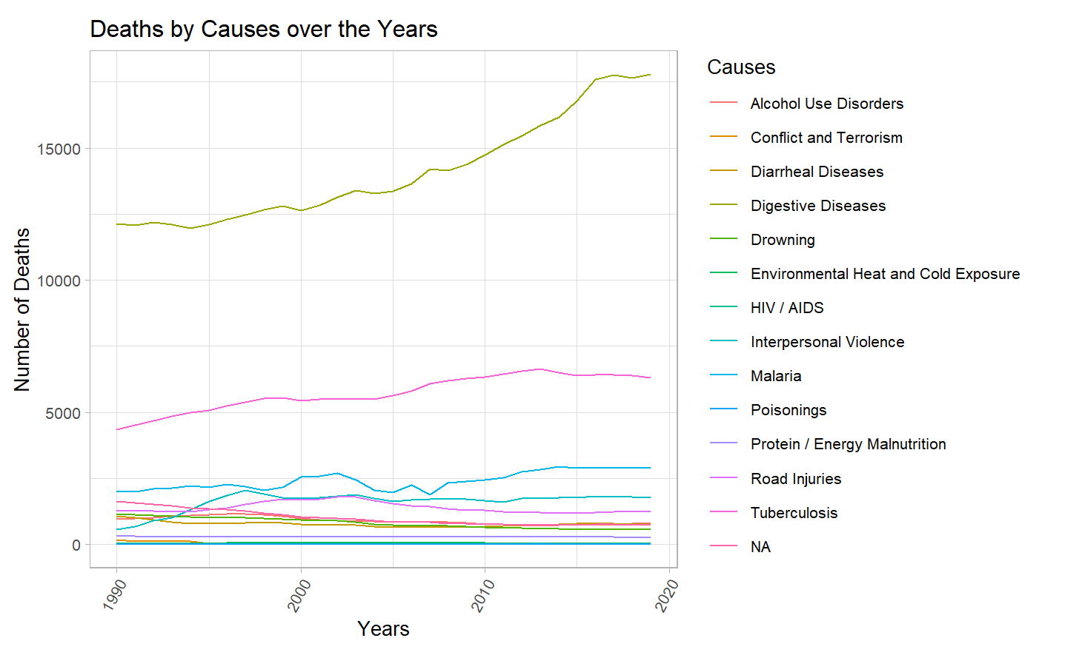
Argentina
Notes:
Rising case of Digestive Diseases and Interpersonal Violence

Slide 20
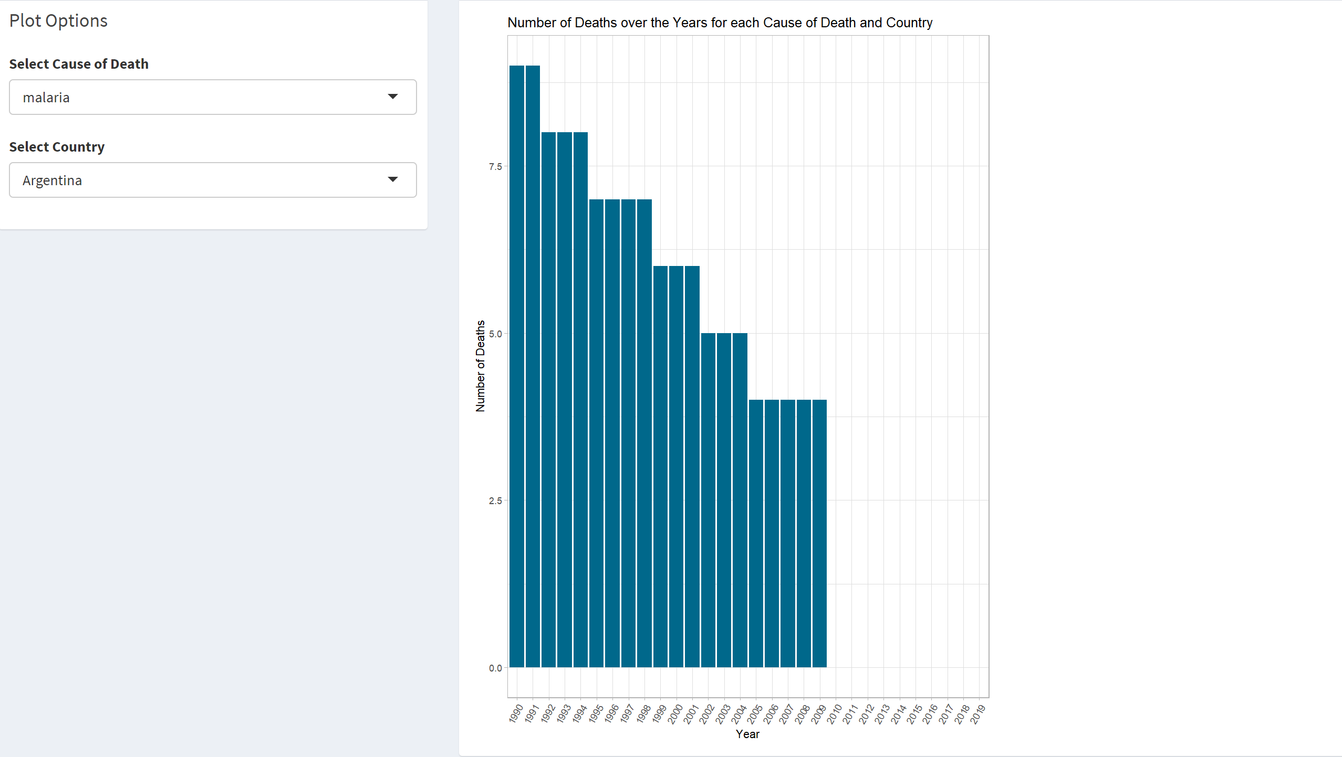
Argentina – Malaria cases dropped
Notes:
Rising case of Digestive Diseases and Interpersonal Violence

Slide 21
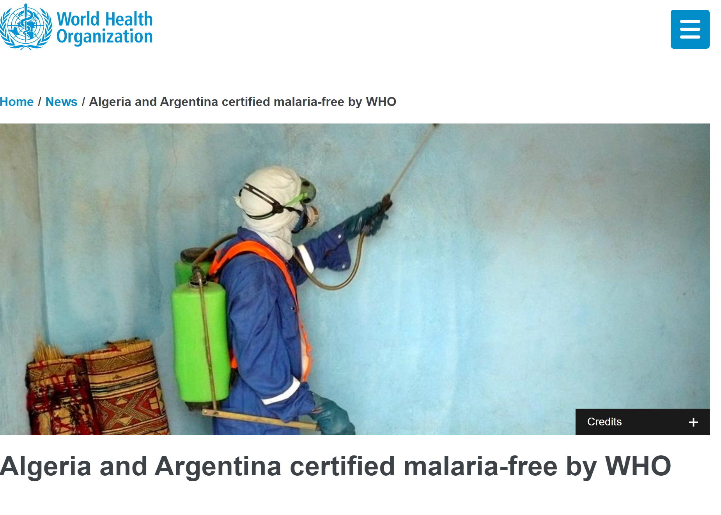
Argentina – Malaria cases dropped
Spraying insecticides
Effective response to communities
Notes:
Rising case of Digestive Diseases and Interpersonal Violence

Slide 22

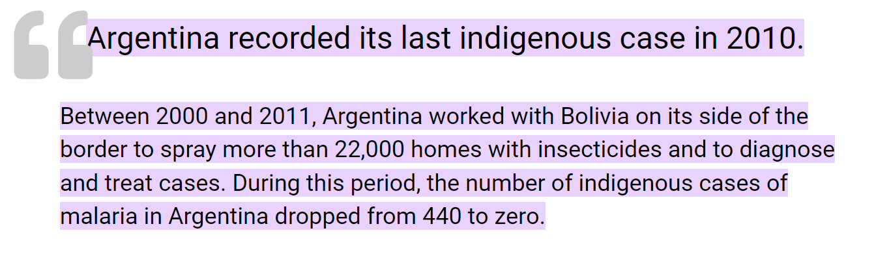
Argentina – Malaria cases dropped
Spraying insecticides
Effective response to communities
Notes:
Rising case of Digestive Diseases and Interpersonal Violence

Slide 23

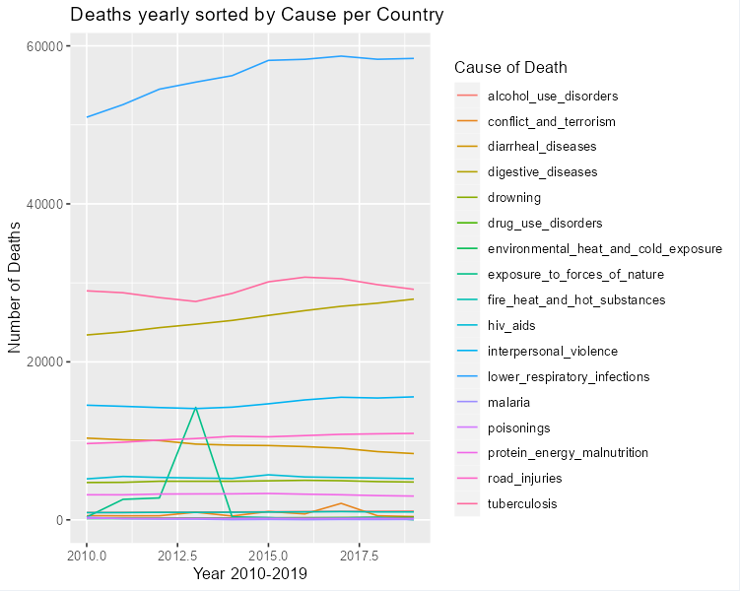
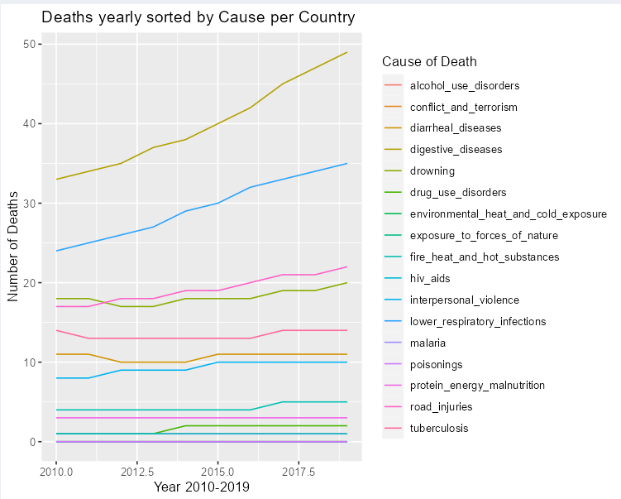
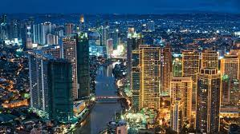
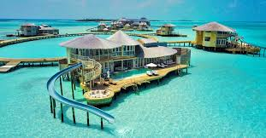
Philippines, What's Happenin?

Slide 24

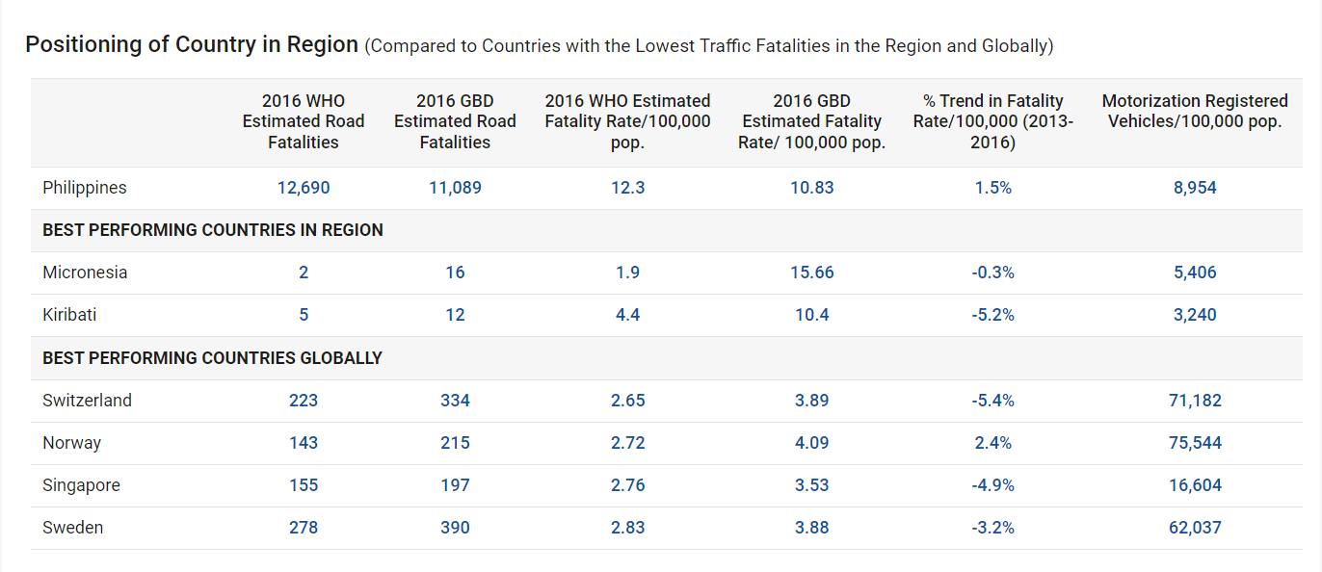
Philippines

Slide 25
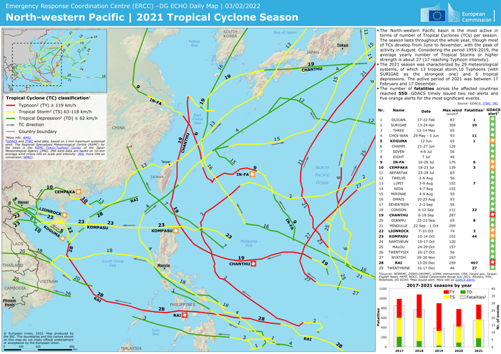
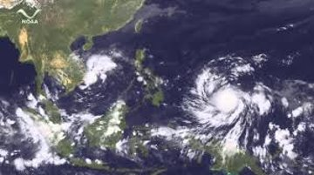
Philippines
Typhoon Haiyan

Slide 26
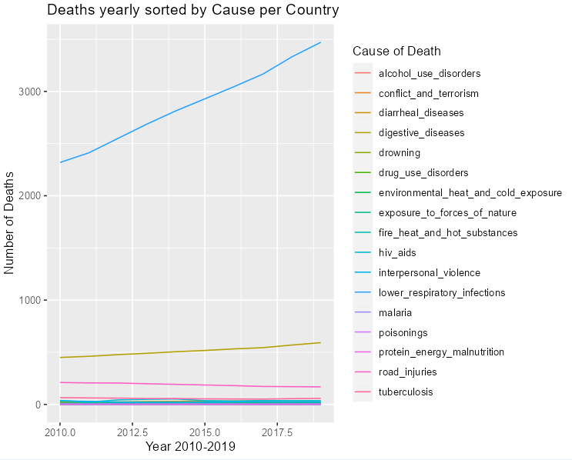

Singapore

Slide 27

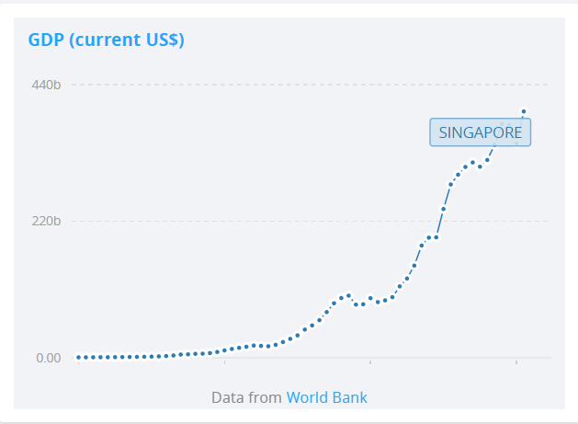
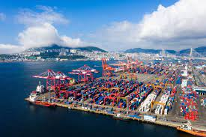
Singapore
Trade and Export
Tourism

Slide 28
Thanks!
Any questions?

Slide 29
https://data.worldbank.org/indicator/NY.GDP.MKTP.CD?locations=SG
https://www.roadsafetyfacility.org/country/philippines
https://www.kaggle.com/datasets/iamsouravbanerjee/cause-of-deaths-around-the-world
https://www.paho.org/en/stories/argentinas-journey-becoming-malaria-free#:~:text=Argentina%20recorded%20its%20last%20indigenous,dropped%20from%20440%20to%20zero.
https://www.who.int/news/item/22-05-2019-algeria-and-argentina-certified-malaria-free-by-who
https://www.ncbi.nlm.nih.gov/pmc/articles/PMC6931006/
https://cruxnow.com/church-in-the-americas/2022/03/violence-against-women-increased-in-brazil-during-pandemic
https://www.ohchr.org/en/statements/2022/11/brazil-un-experts-urge-new-government-target-violence-against-women-and-girls

